Slide 1




BCG
From Features to Insights: A Comprehensive Analysis of Housing Prices
YASSINE ELMOUHI
Get Started

Slide 2
Plan of Contents
1
Data Overview
2
Data Preparation
3
Regression Analysis
4
Clustering Analysis

Slide 3
CHRONOLOGIE
DATA OVERVIEW
3

Slide 4
Data overview
1
Dataset Description
2
Some Key Features
4

Slide 5

1- DATASET DESCRIPTION
Content : The dataset consists of observations of various house features.
Size : The dataset includes a total of 1460 observations and 80 features.
Objective : This study aims to better understand trends in the housing market and uncover valuable insights that can inform business decisions.
5

Slide 6
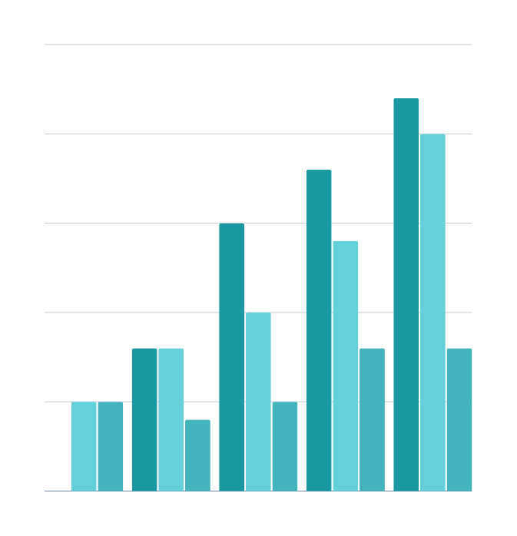
2- SOME KEY FEATURES
Lot Area: Total lot size.
Living Area: Above-grade living space.
Bedrooms: Total number of bedrooms.
Garage Cars: Parking capacity available.
Full Bathrooms: Total number of full bathrooms
SalePrice: Final selling price
6

Slide 7
CHRONOLOGIE
DATA OVERVIEW
DATA PREPARATION
7

Slide 8
1
Data Types Overview
Data Preparation
2
Finding Variables with missing values
3
Correlation Analysis and Feature Reduction
4
Scatter Plots Analysis
5
Missing data
6
Identifying Outliers
8

Slide 9
1 - Data Types Overview
INTEGER (INT64)
FLOAT (FLOAT64)
CATEGORICAL (OBJECT)
year_constructed, garagecars, bedroomabvgr
grlivarea, masvnrarea, saleprice
zoning_ms, neighborhood, heating
9

Slide 10
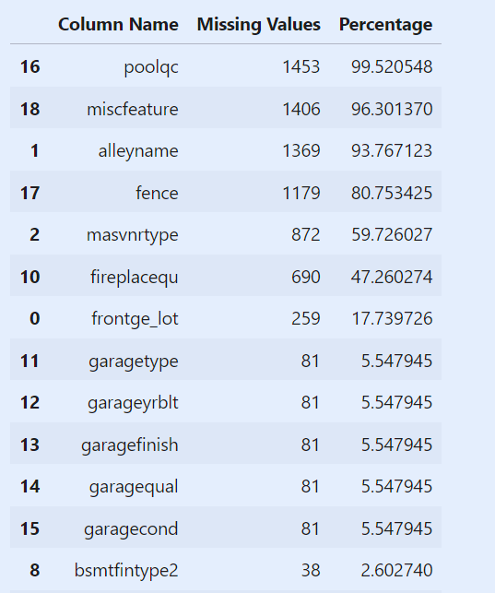
2- FINDING VARIABLES WITH MISSING VALUES
Variables with over 45% missing values were removed to maintain data quality and consistency.
For the remaining missing values, we’ll address them after conducting dimensionality reduction. This approach ensures we don’t fill variables that may later be discarded and avoids potential biases in correlation and feature relationship studies.
10

Slide 11
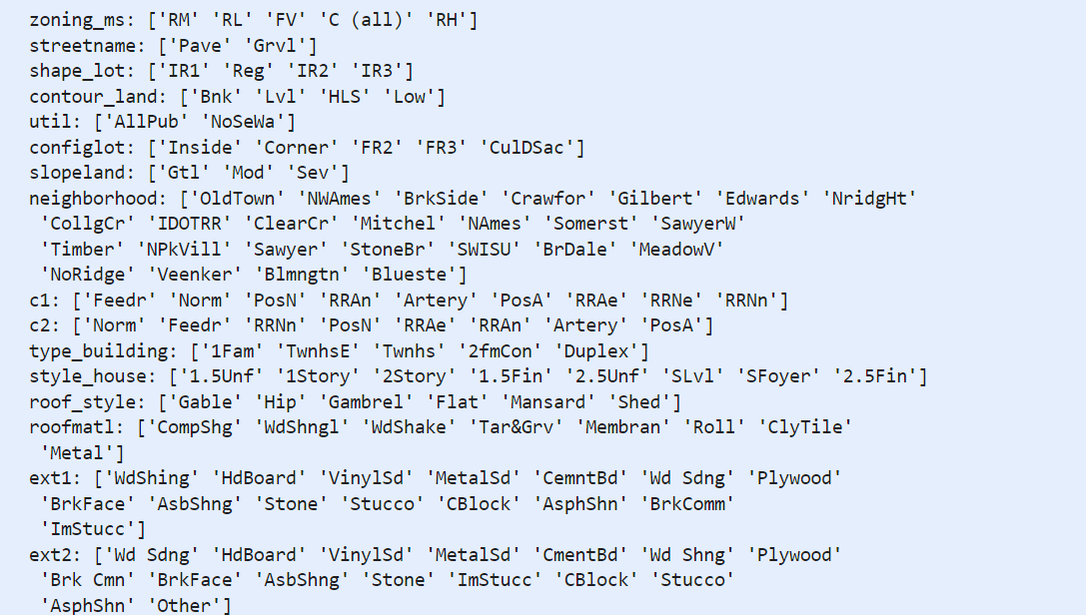
3 -CORRELATION ANALYSIS AND FEATURE REDUCTION
3-1 CATEGORICAL VARIABLE REVIEW
To perform correlation analysis and feature reduction effectively, we need to preprocess categorical variables.
Mapping ordinal variables
Nominal variables one-hot encoding
11

Slide 12
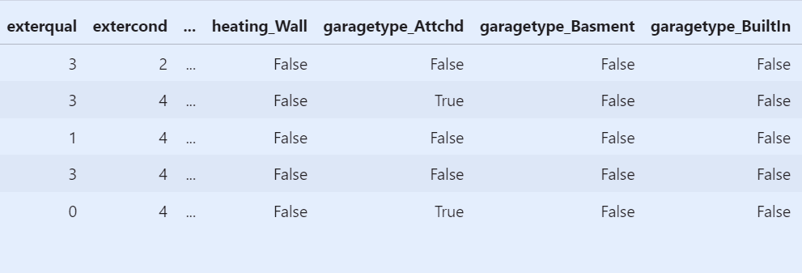
3 -CORRELATION ANALYSIS AND FEATURE REDUCTION
3.2 MAPPING ORDINAL VARIABLES & ONE-HOT ENCODING NOMINAL VARIABLE
12

Slide 13
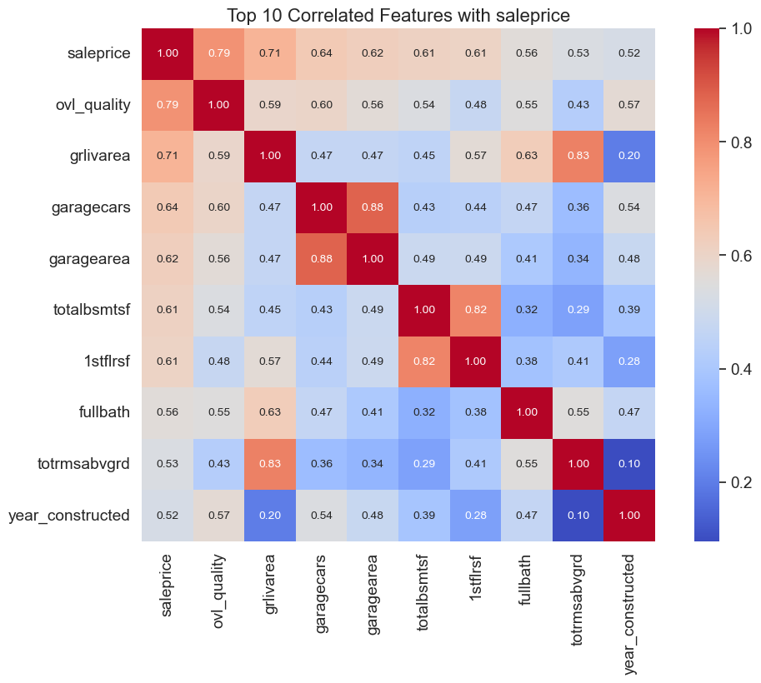
3 -CORRELATION ANALYSIS AND FEATURE REDUCTION
3.3 CORRELATION MATRIX ANALYSIS
full bath ?
13

Slide 14
3 -CORRELATION ANALYSIS AND FEATURE REDUCTION
3.3 CORRELATION MATRIX ANALYSIS
Variables | Observation | Decision
OverallQual, GrLivArea, TotalBsmtSF | strongly correlated with Sale Price. This suggests that these features significantly influence how much a property sells for. In other words, better quality and larger living areas usually lead to higher sale prices. | -
Garage Cars (GarageCars) and Garage Area (GarageArea) | show a strong correlation of approximately 0.88. This makes sense, as both variables essentially provide similar information regarding the garage's capacity. | Keep GarageCars only, as it is more strongly correlated with SalePrice
TotRmsAbvGrd, GrLivArea | another pair of highly correlated variables | Eliminate TotalRmsAbvGrd and keep GrLivArea, as it is more strongly correlated with SalePrice
14

Slide 15
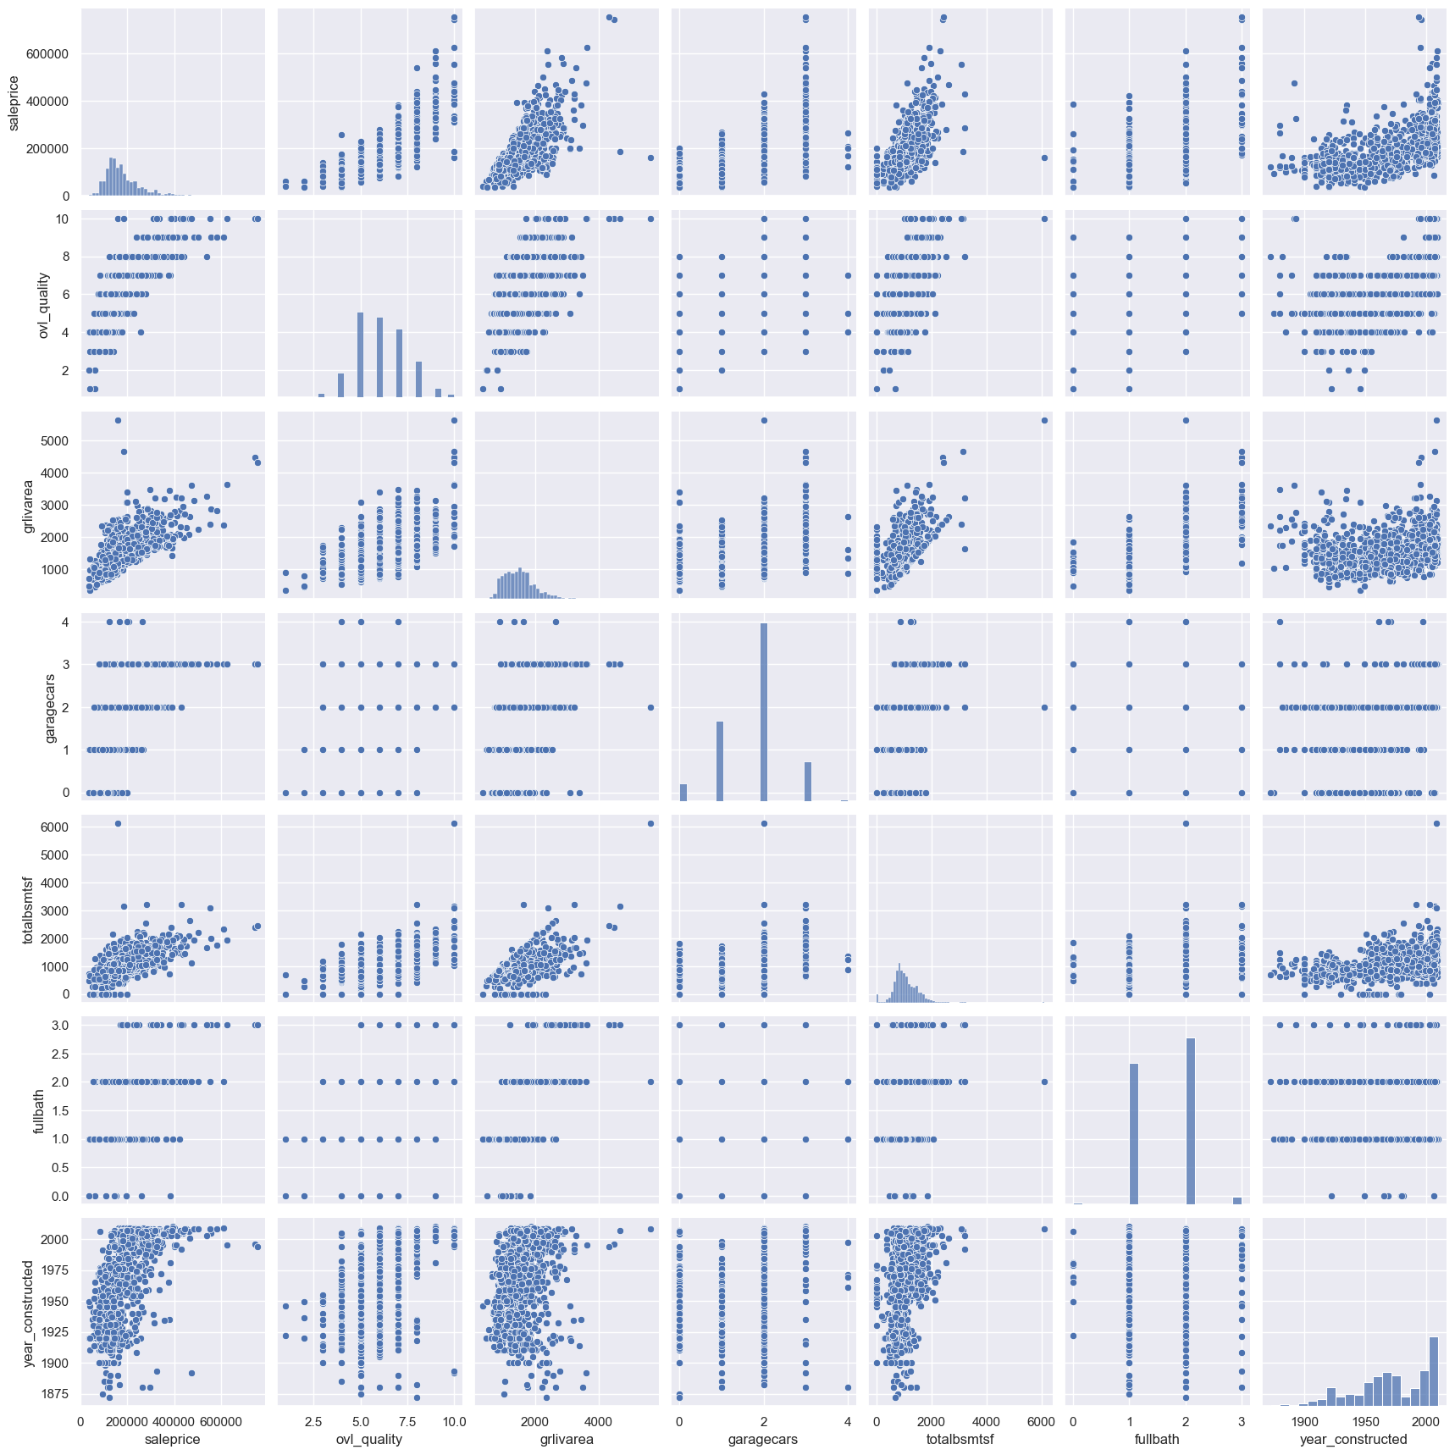
4- SCATTER PLOTS ANALYSIS
15

Slide 16
INSIGHTS FROM SCATTER PLOTS
The scatter plots reveal valuable insights that enhance our understanding of the data:
TotalBsmtSF vs. GrLivArea : The plot shows a clear linear pattern where most data points cluster below the line. It makes sense that the basement area (TotalBsmtSF) would not exceed the above-ground living area (GrLivArea). While the two areas can be equal, it’s rare for the basement area to surpass the living space above ground.
SalePrice vs. YearBuilt: This scatter plot presents an interesting relationship. At the lower end, there's a subtle exponential trend indicating that older houses generally have lower sale prices. In contrast, newer builds typically fetch higher prices. The most recent years are positioned above the upper trend line, indicating a sharp rise in property values in today’s market.
16

Slide 17
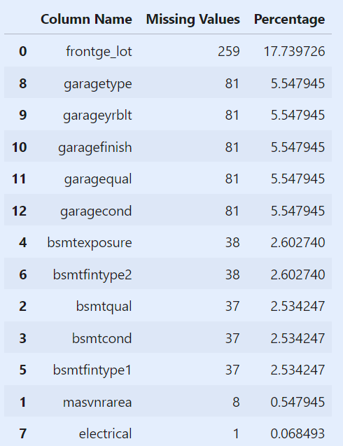
5- MISSING DATA
After conducting the correlation analysis, we still have some variables with missing data that we need to address
Frontge_Lot: Given that the frontge_lot column has approximately 17% missing data and is not critical for our analysis, we will remove this column from the dataset.
Electrical: We have just one missing observation in 'electrical'. Since it's only one, we will remove this single observation and keep the variable.
GarageX Variables: The 'GarageX' variables have the same number of missing entries, likely referring to the same set of observations. Given that these missing values constitute only about 5%, we will not spend excessive time delving into them. Considering that the most critical information about garages is captured by 'GarageCars', and the missing values are not substantial, we'll remove these 'GarageX' variables.
BsmtX Variables: A similar rationale applies to the 'BsmtX' variables. We'll remove these variables as well.
MasVnrArea: For 'masvnrarea', we will fill in the missing values with 0, assuming that a missing entry indicates no masonry veneer area.area.
17

Slide 18
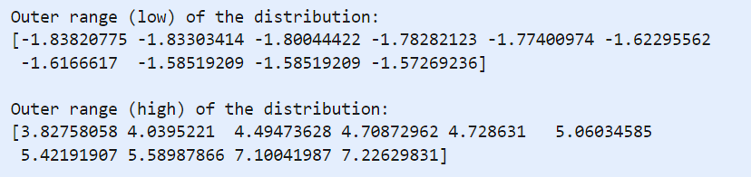


6- IDENTIFYING OUTLIERS
Standardize the SalePrice data.
Define the outlier Threshold
Visualize the lower and upper outer ranges of the distribution.
Visualize the distribution of SalePrice
The negative values are close to zero, which looks normal. However, the high values above 7 could be problematic. We should take a closer look at those outliers.
18

Slide 19
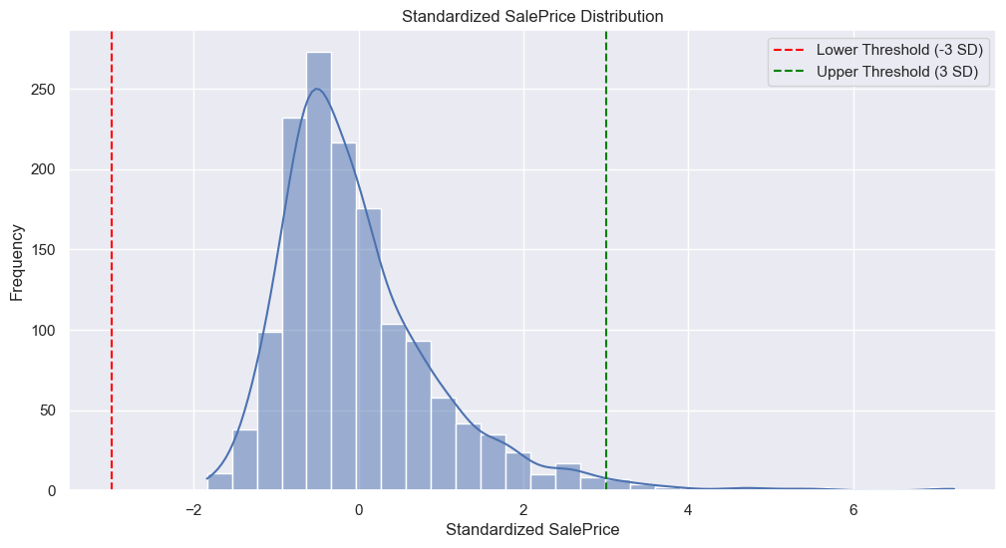
STANDARDIZED SALEPRICE DISTRIBUTION
19

Slide 20
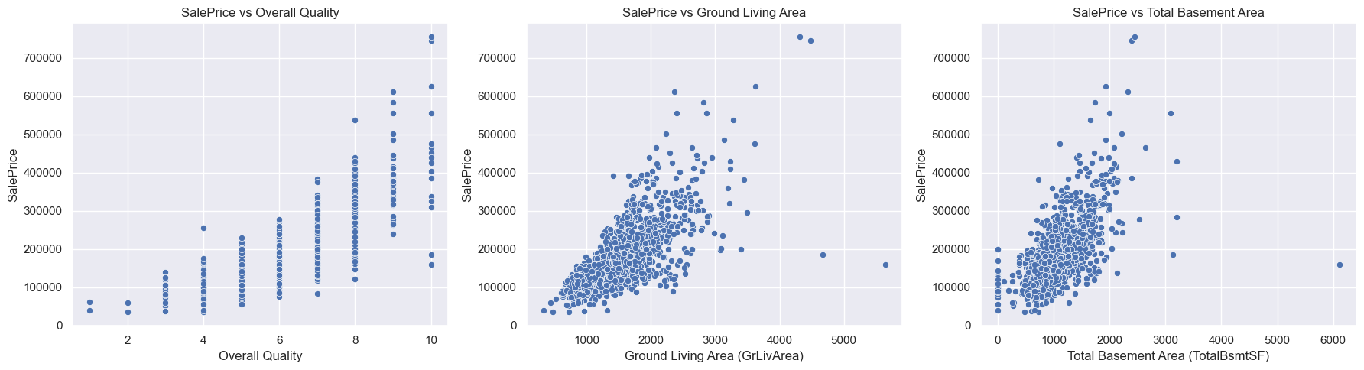
ANALYZING OUTLIERS IN SALEPRICE
Now that we have identified the outlier values in the `SalePrice`, particularly those above 7 in the standardized scale, we will further investigate these observations.
To do this, we will create scatter plots to visualize the relationships between SalePrice and three different variables:
Overall Quality (ovl_quality)
Ground Living Area (grlivarea)
Total Basement Area (totalbsm)
20

Slide 21
Outlier Analysis Results :
Ground Living Area (GrLivArea):
The two values with the largest GrLivArea appear to be outliers. They significantly deviate from the majority of the data points and do not align with the overall trend.
One possible explanation for this discrepancy is that these values may correspond to agricultural areas, which could account for their relatively low sale prices. Given that these points do not represent typical cases, we will classify them as outliers and proceed to remove them from our dataset.
Sale Price Observations:
The two observations at the top of the plot, which correspond to the highest saleprice values (around 7.something), do not appear to be outliers in the same sense. While they are notably high, they seem to follow the established trend of the data.
Therefore, we will retain these two observations in our dataset, as they may represent valid, high-value properties.
21

Slide 22
CHRONOLOGIE
DATA OVERVIEW
DATA PREPARATION
REGRESSION ANALYSIS
22

Slide 23
1
Assumptions of Regression
Regression Analysis
2
Feature Scaling, Mapping, and One-Hot Encoding
3
Dividing Data into Training and Test Sets
4
Training & Evaluating the Model
5
Insights and Recommendations
23

Slide 24
Hopes and Expectations
Objective of Regression Analysis:
We aim to identify features that significantly influence sale prices, both positively and negatively.
Why Regression?
By understanding these relationships, we can make informed decisions that maximize our gains in the housing market.
Anticipated Outcomes:
Pinpointing key features that enhance property value.
Recognizing features that may detract from sale prices.
24

Slide 25

1. ASSUMPTIONS OF REGRESSION
Before proceeding with regression analysis, it is essential to verify that the following assumptions are met:
Normality
Homoscedasticity
Linearity : Linearity was evaluated as part of our outlier analysis
Absence of Correlated Errors : We've already conducted a correlation study to address potential correlation issues among features.
25

Slide 26
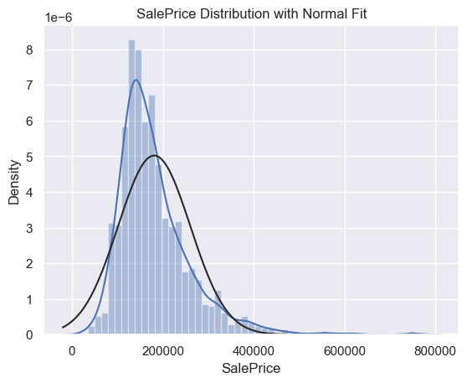
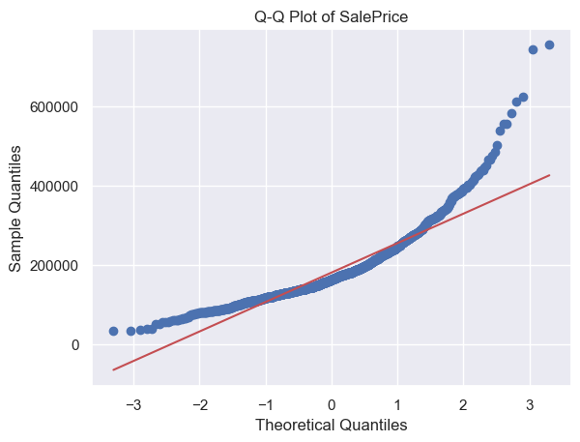
1. ASSUMPTIONS OF REGRESSION
1-1 STUDY OF LINEARITY FOR SALEPRICE
26

Slide 27
1. ASSUMPTIONS OF REGRESSION
1-1 STUDY OF LINEARITY FOR SALEPRICE
Remark on SalePrice Normality :
Distribution Characteristics:
The distribution of 'SalePrice' is not normal; it shows peakedness and positive skewness, deviating from the diagonal line in the Q-Q plot.
Transformation Approach:
To address the positive skewness, we will first apply log transformations, which often help in normalizing skewed data.
Alternative Considerations:
If the transformations do not adequately normalize the data, we may need to explore other regression techniques that are better suited for non-normally distributed data.
27

Slide 28
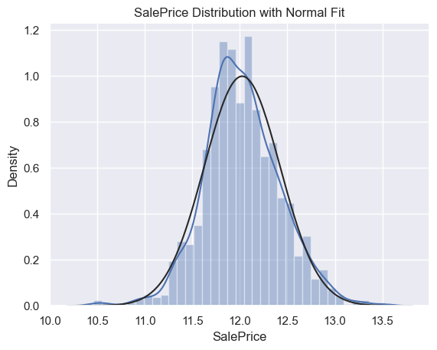
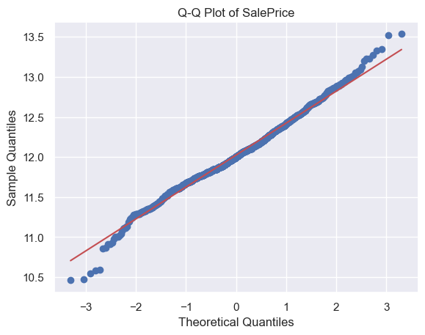

1. ASSUMPTIONS OF REGRESSION
1-1 STUDY OF LINEARITY FOR SALEPRICE
Log transformations worked for SalePrice, and the same transformation was applied to GrLivArea
28

Slide 29
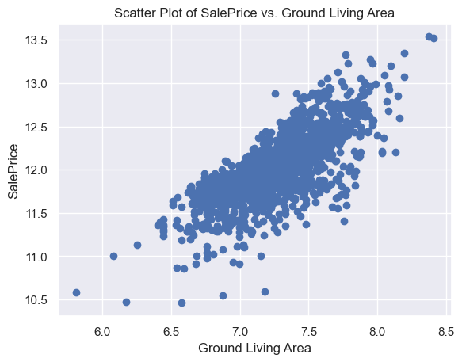
1. ASSUMPTIONS OF REGRESSION
1-2 STUDY OF HOMOSCEDASTICITY
In this analysis, we will start by examining the relationship between 'SalePrice' and 'grlivarea'. The scatter plot will help us visualize any potential patterns in the dispersion of the data points.
WE CAN CONCLUDE THAT THE CONDITION OF HOMOSCEDASTICITY HAS BEEN MET.
We've checked all assumptions, so we can proceed with our analysis.
29

Slide 30



2- FEATURE SCALING, MAPPING, AND ONE-HOT ENCODING
01 - Mapping
Map ordinal variables.
02 - One-Hot Encoding
One-hot encode nominal variables.
03 - Feature Scaling
Use a standard scaler to standardize our features.
30

Slide 31
SELECTING THE TOP 10 IMPORTANT FEATURES
To enhance the accuracy of our regression model, it's crucial to identify and select the most important features. By focusing on these key variables, we can reduce complexity and prevent overfitting, ultimately improving model performance.
We utilized the Random Forest Regressor for this purpose, as it effectively ranks features based on their importance in predicting the target variable. By selecting the top 10 important features, we ensure that our model is both efficient and reliable.
31

Slide 32
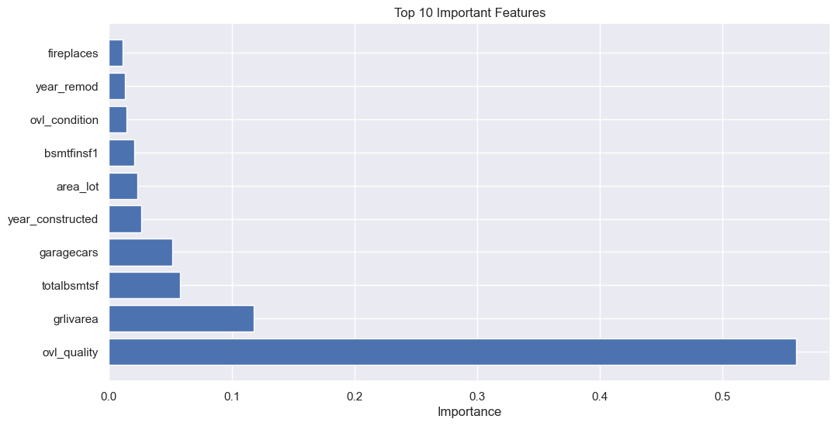
SELECTING THE TOP 10 IMPORTANT FEATURES
32

Slide 33
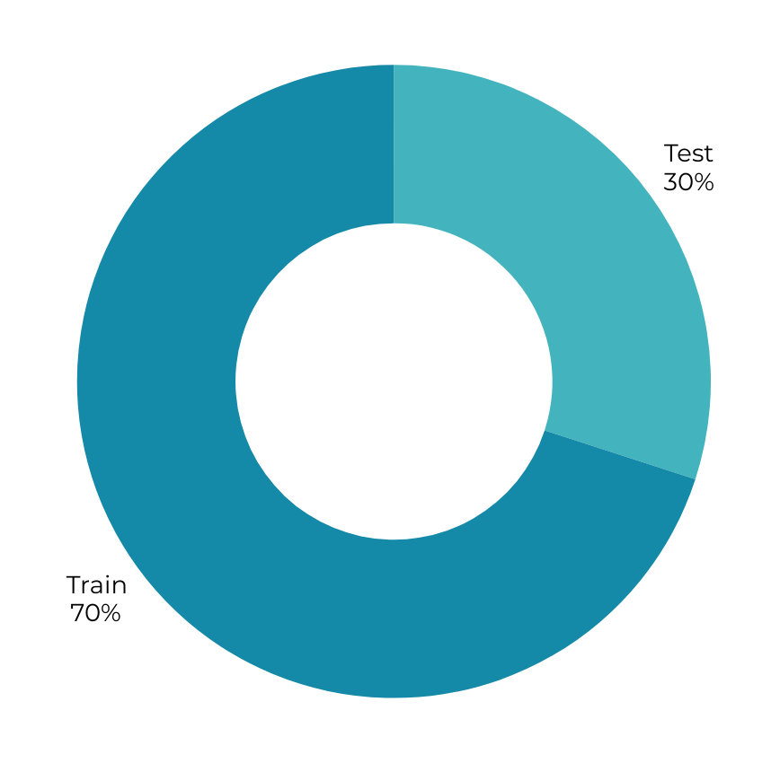
3- DIVIDING DATA INTO TRAINING AND TEST SETS
33

Slide 34
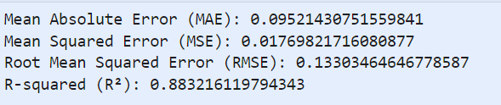
4- TRAINING & EVALUATING THE MODEL
After fitting our model, we’ll evaluate its performance on the test set using these metrics:
34

Slide 35
MODEL PERFORMANCE EVALUATION
Mean Absolute Error (MAE): 0.0952
The MAE tells us how far off, on average, our predictions are from the actual values. In this case, an MAE of 0.0952 means that our predictions are typically about 9.52% off. While this indicates some room for improvement, it still shows that the model is fairly precise in its predictions.
Mean Squared Error (MSE): 0.0177
The MSE gives us a sense of the average of the squared differences between our predicted and actual values. A lower MSE generally indicates fewer errors, and here we see a value of 0.0177. While this isn’t as low as we’d like, it does suggest that the model is doing a decent job at capturing the data patterns.
Root Mean Squared Error (RMSE): 0.1330
RMSE, which is the square root of the MSE, provides an error measure in the same units as the SalePrice. With an RMSE of 0.1330, this suggests that our predictions are off by about 13.30% on average. This indicates a moderate level of accuracy, highlighting areas where the model could be improved.
R-squared (R²): 0.8832
R² tells us how much of the variance in SalePrice our model is able to explain. Here, the value is 88.32%, which is quite good. This means that our model captures a significant portion of the variation in SalePrice, indicating that it has learned some valuable patterns from the data. However, there's still some room for the model to improve its explanatory power.
Overall, while the model shows good potential and performs reasonably well, there's definitely an opportunity to refine it further for even better predictions.
35

Slide 36
5- INSIGHTS AND RECOMMENDATIONS
Key Insights :
Most Influential Factors: Our analysis revealed that Overall Quality, Above-Ground Living Area (GrLivArea), and Total Basement Area (TotalBsmtSF) are among the most influential features affecting property sale price. Investing in these areas can significantly increase property value.
Importance of Property Age and Condition: Properties that are newer or well-maintained, as indicated by Year Built and Overall Condition, generally sell for higher prices. Regular maintenance, especially of high-impact areas like the basement and garage, can positively impact sale price.
Value of Garage and Living Space: Features like Garage Capacity (GarageCars) and Above-Ground Living Area correlate strongly with sale price. Buyers appear willing to pay more for properties with ample parking and spacious living areas.
36

Slide 37
5- INSIGHTS AND RECOMMENDATIONS
Recommendations for Business Strategy
Focus on High-Impact Renovations: Prioritize upgrades in areas like living space and quality finishes. Expanding or enhancing basement space or adding quality interior features can provide high returns.
Strategic Property Marketing: Highlight key strengths in listings, such as ample living space or recent renovations, to attract buyers interested in well-kept and newer properties.
Informed Pricing Decisions: Use insights from the model to guide pricing. Properties lacking in key features like high-quality finishes or large basement areas may need competitive pricing to attract buyers.
37

Slide 38
CHRONOLOGIE
DATA OVERVIEW
DATA PREPARATION
REGRESSION ANALYSIS
CLUSTERING ANALYSIS
38

Slide 39
Clustering Analysis
1
Finding the Optimal Number of Clusters (k)
2
Cluster Analysis: garagecars vs area_lot
3
Insights and Recommendations
39

Slide 40
Identifying High-Value Segments :
Clusters with higher sale prices can reveal desirable features (like location or amenities) to target for renovations or marketing.
Why Clustering?
& Expected Insights
Cost Optimization Opportunities
Clusters with lower value but high costs can be optimized to reduce expenses without sacrificing buyer appeal.
Targeted Marketing and Pricing
Distinct clusters, like "luxury" or "starter" homes, allow for customized marketing and pricing strategies to attract specific buyer types.
Enhanced Decision-Making
Clustering helps prioritize upgrades, refine pricing, and support strategic decisions across different home categories.
40

Slide 41
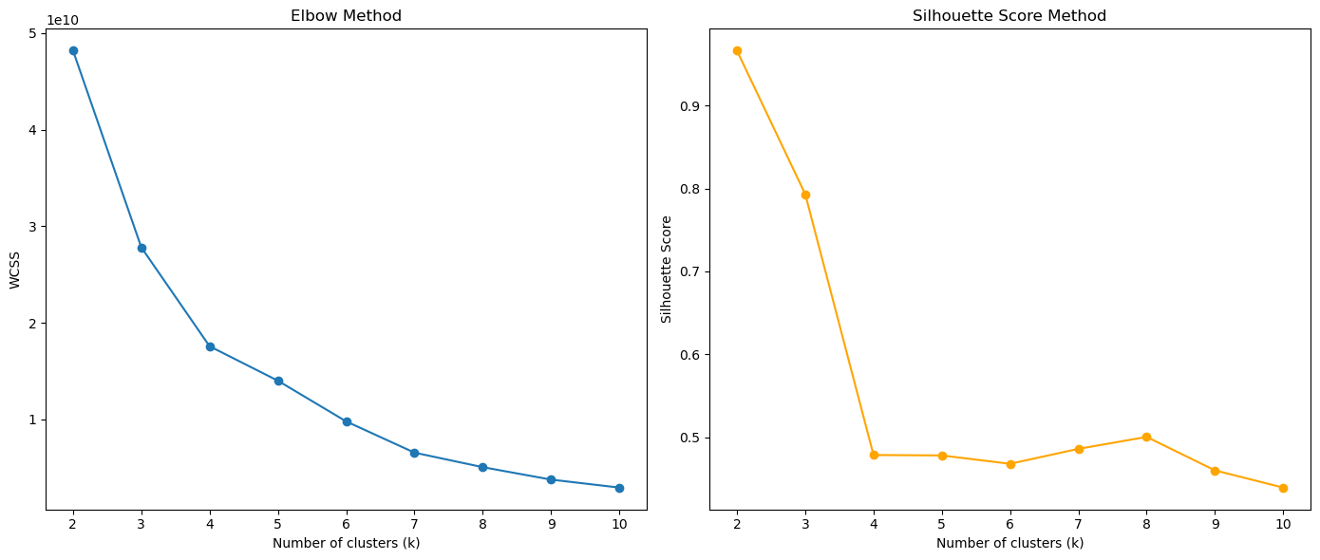
1. FINDING THE OPTIMAL NUMBER OF CLUSTERS (K)
To determine the ideal number of clusters, we applied the Elbow Method and Silhouette Score. These approaches help us choose the most meaningful kkk for well-defined clustering, supporting accurate segmentation and insight
We'll proceed with k=3
41

Slide 42
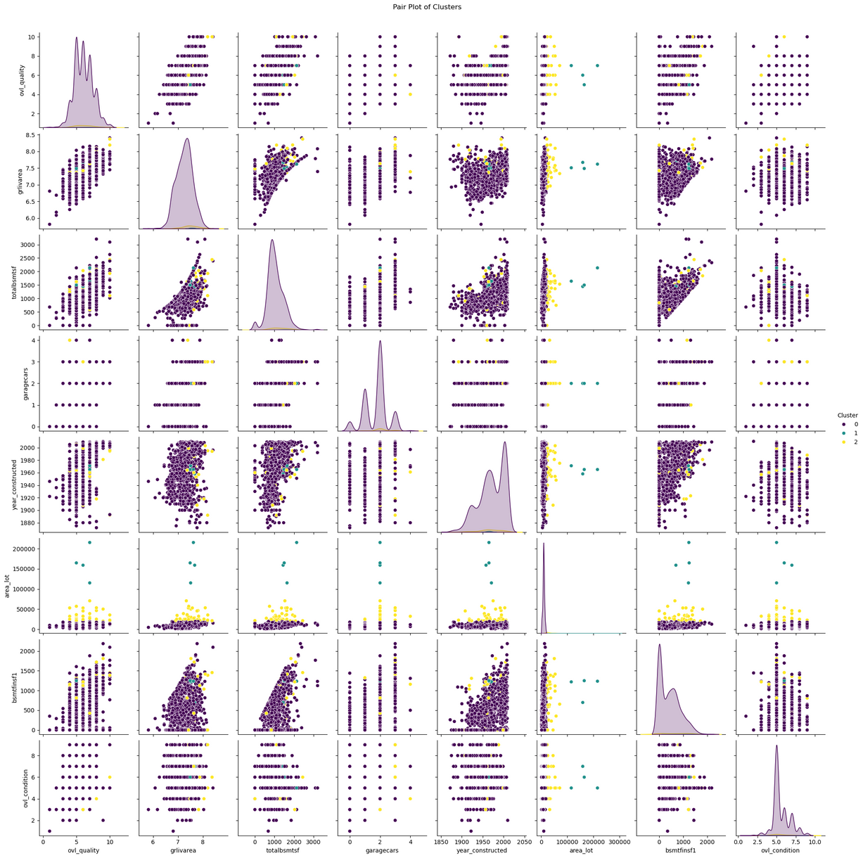
2. CLUSTER ANALYSIS: PAIRWISE PLOTS
k = 3 !
42

Slide 43
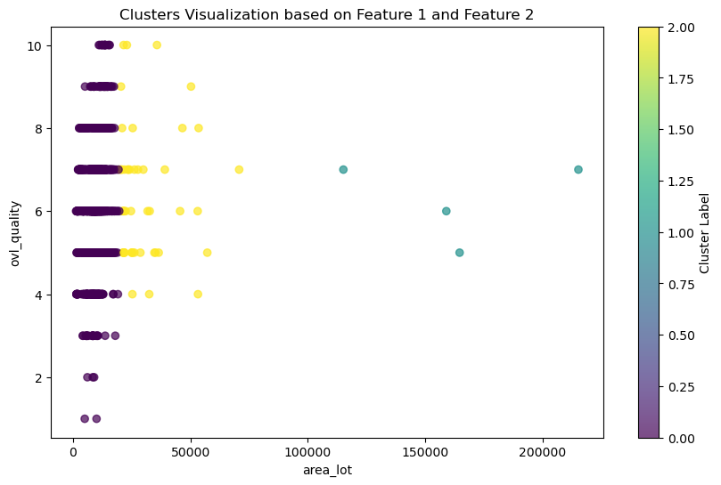
2. CLUSTER ANALYSIS: OVL_QUALITY VS AREA_LOT
43

Slide 44
2. CLUSTER ANALYSIS: OVL_QUALITY VS AREA_LOT
CLUSTERING INTERPRETATION :
Most customers fall into Cluster 1, which shows that they tend to prefer smaller lot sizes. This trend suggests that many buyers are likely looking for affordable options, easier maintenance, or prime locations rather than larger properties. On the other hand, the smaller group in Cluster 2 favors larger lots along with high quality, indicating that they are a niche market that appreciates spacious, premium homes.
44

Slide 45
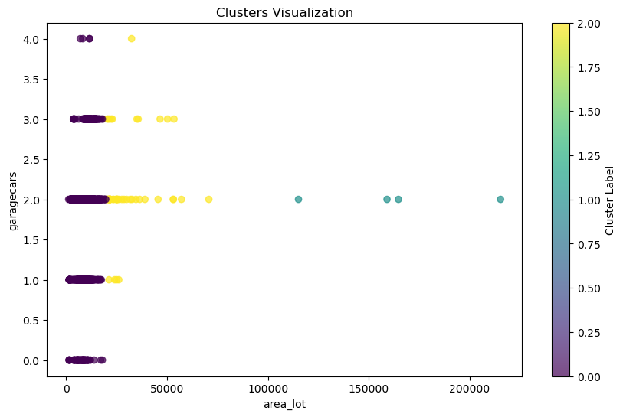
2. CLUSTER ANALYSIS: GARAGECARS VS AREA_LOT
45

Slide 46
2. CLUSTER ANALYSIS: GARAGECARS VS AREA_LOT
CLUSTERING INTERPRETATION :
The clustering results reveal that most customers prefer properties with smaller to medium lot areas that include garage space, indicating a strong inclination towards practicality and convenience over extensive outdoor space. This trend suggests that many buyers are more interested in investing in garage space, opting for homes with smaller or medium lots rather than larger properties that may offer little or no garage options. Overall, the findings highlight a market trend where functionality and convenience, particularly regarding parking, are key factors driving buyer preferences.
46

Slide 47
3- INSIGHTS AND RECOMMENDATIONS
Smaller Lots Are In Demand: The preference for smaller lot sizes suggests that many buyers want homes that require less upkeep, especially as more people live in urban areas where space is limited.
Garage Space Matters: It’s clear that having a garage is a significant factor for buyers, highlighting their desire for convenience and security for their vehicles.
Target Smaller Properties: Real estate developers and agents should focus on creating smaller lot homes that include garages, as this aligns with the majority of buyers' preferences for practical and affordable living.
47

